Slide 1


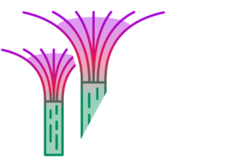

MeshA*:
Efficient Path Planning With Motion Primitives
Marat Agranovskiy¹, Konstantin Yakovlev^{1,2}
¹Saint-Petersburg University
²AIRI
23 January 2026, Singapore
Marat’s travel was supported by Pinely

Slide 2

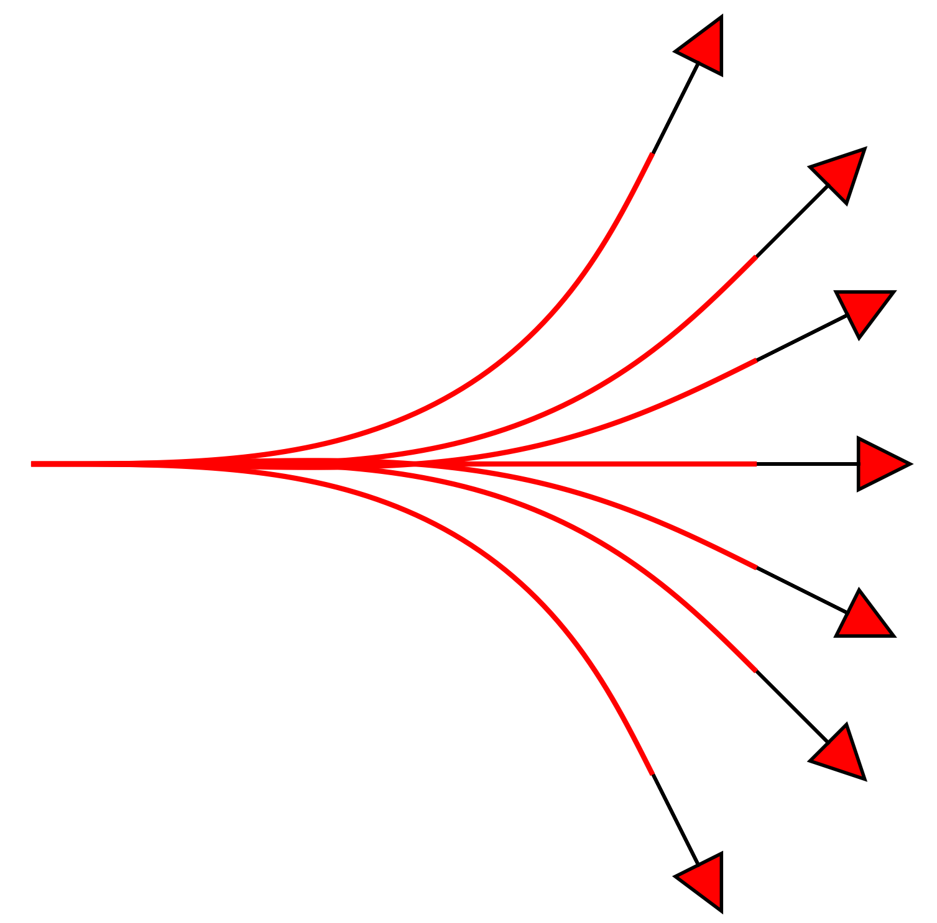
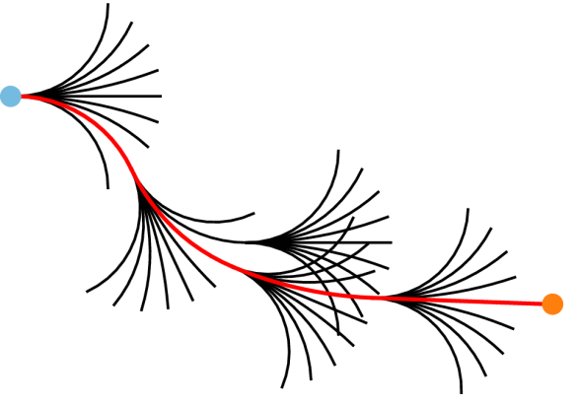
Motivation: Lattice-Based Path Planning
Goal: Planning smooth, feasible trajectories for non-holonomic agents (e.g., self-driving vehicles).
Approaches: Sampling-based (RRT), Optimization-based, and Lattice-based (graph search).
Our focus: Lattice-Based Planning:
Discretizes state space s = (x, y, θ).
Motion Primitives: Short, pre-computed, feasible motion segments.
Algorithm: A* searches for a sequence of primitives that smoothly connect.
Image from: Thoresen, Marius & Nielsen, Niels & Mathiassen, Kim & Pettersen, K.Y.. (2021). Path Planning for UGVs based on Traversability Hybrid A*. IEEE Robotics and Automation Letters. PP. 1-1. 10.1109/LRA.2021.3056028.

Slide 3
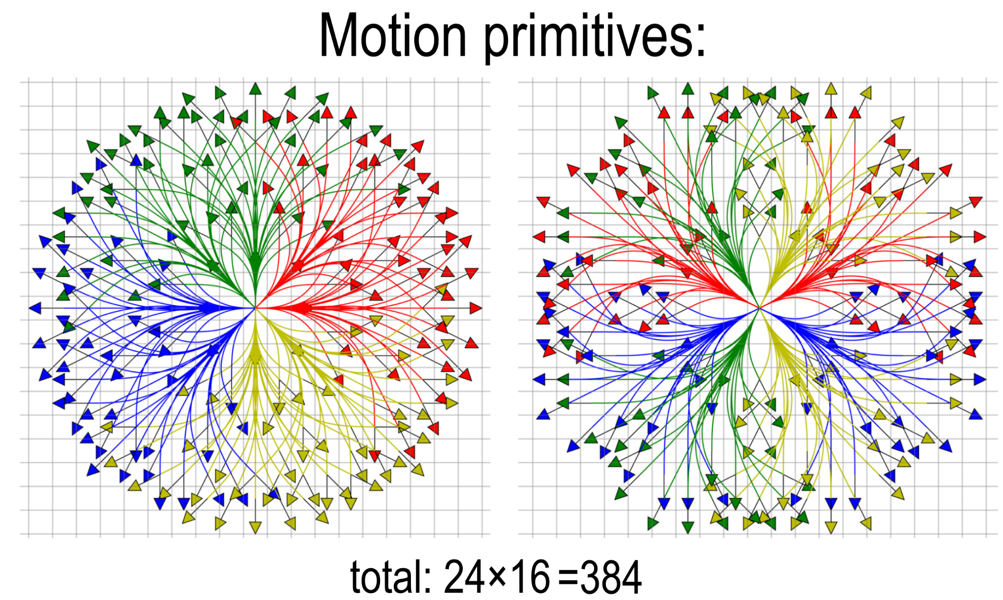
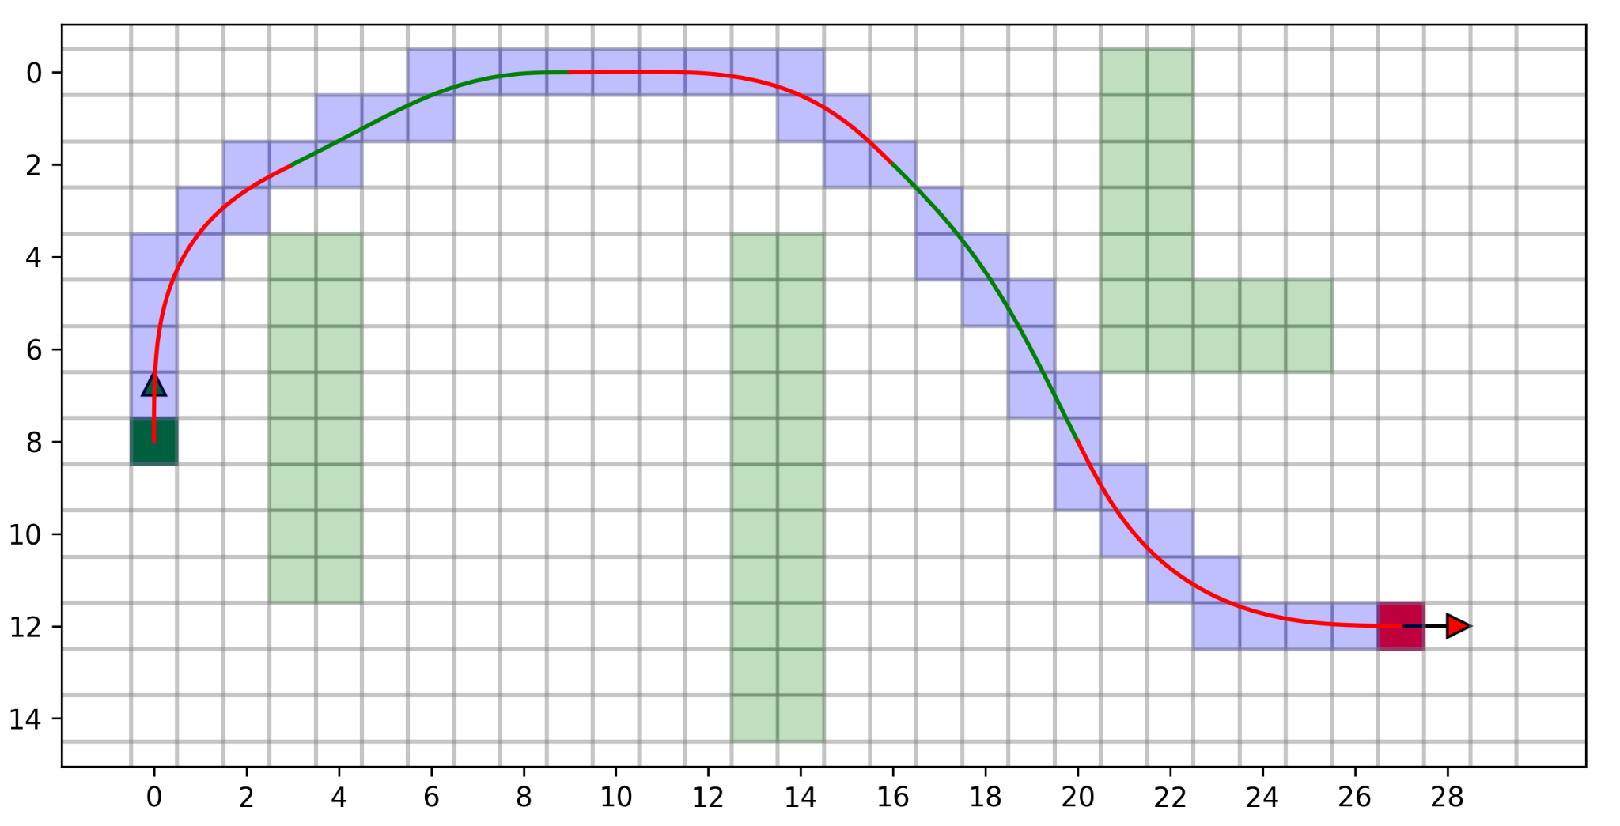
Problem Statement
Workspace & State Representation
Workspace: A 2D grid of free/blocked cells.
State s = (i, j, θ): Agent is located at the center of grid cell (i, j) with a discrete heading θ.
Motion Primitives
Short, kinodynamically feasible motions connecting two discrete states: (i, j, θ) → (i', j', θ').
Associated with a collision trace (sequence of swept cells) and cost.
Control Set: A canonical finite set of motion templates, encapsulates all kinematic constraints.
Objective: Find a collision-free path (sequence of primitives from the control set) with minimal cost.
Green/red primitives and blue collision trace

Slide 4
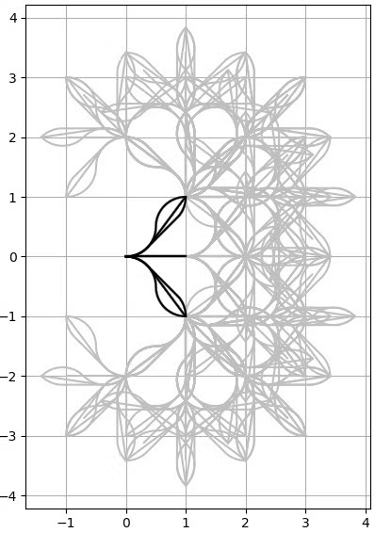
The Challenges
To achieve high-quality motion planning, we need a rich set of motion primitives.
This inevitably leads to a high branching factor in the search graph.
Lattice-based A* (LBA*) must generate and collision-check all applicable primitives for every state (i, j, θ).
Lazy approaches (LazyLBA*): postpone collision checks but frequently expand invalid states in cluttered environments.
The search tree is flooded with unpromising (LBA*) or invalid (LazyLBA*) partial paths.
Images from:
[1] A. Botros and S. L. Smith, "Computing a Minimal Set of t-Spanning Motion Primitives for Lattice Planners," 2019 IEEE/RSJ International Conference on Intelligent Robots and Systems (IROS), Macau, China, 2019, pp. 2328-2335, doi: 10.1109/IROS40897.2019.8968150.
[2] Thoresen, Marius & Nielsen, Niels & Mathiassen, Kim & Pettersen, K.Y.. (2021). Path Planning for UGVs based on Traversability Hybrid A*. IEEE Robotics and Automation Letters. PP. 1-1. 10.1109/LRA.2021.3056028.

Slide 5
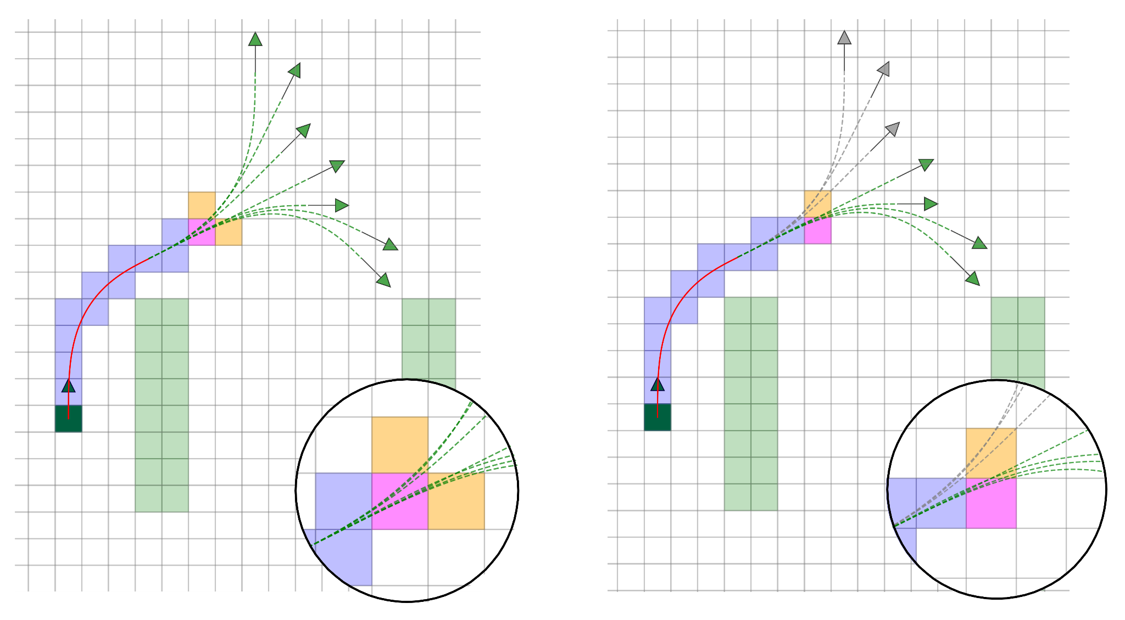
MeshA*: A New Perspective
State Lattice (graph of primitives) → Mesh Graph (graph of cells).
Key Insight: Cell-Centric Expansion
Do not jump from state to state via full primitives.
Instead, step through the environment cell-by-cell.
Reason simultaneously about the grid cell and the set of primitives passing through it.
The Benefit: Early Pruning
We can detect collisions or high costs immediately as we enter a cell.
Allows pruning unpromising branches before a primitive is fully traversed/expanded.
Intuition behind MeshA*: The current cell (magenta) stores a set of active primitives (green). Moving to a specific neighbor (orange) effectively filters this set, keeping only the primitives that actually traverse that neighbor and discarding the rest (gray).

Slide 6
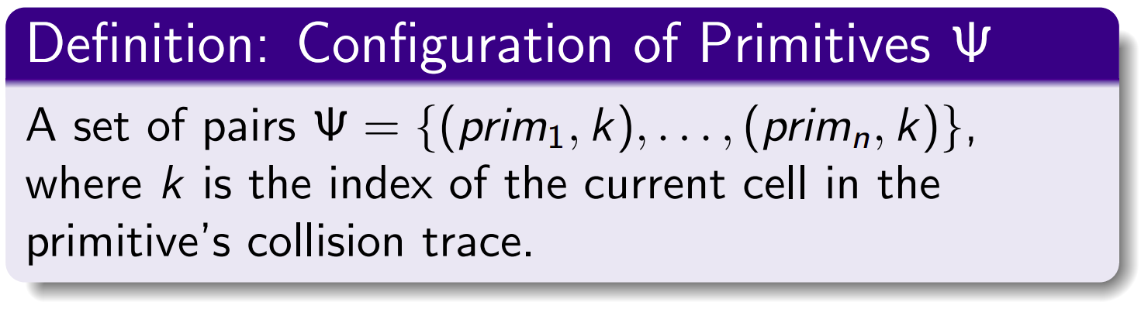
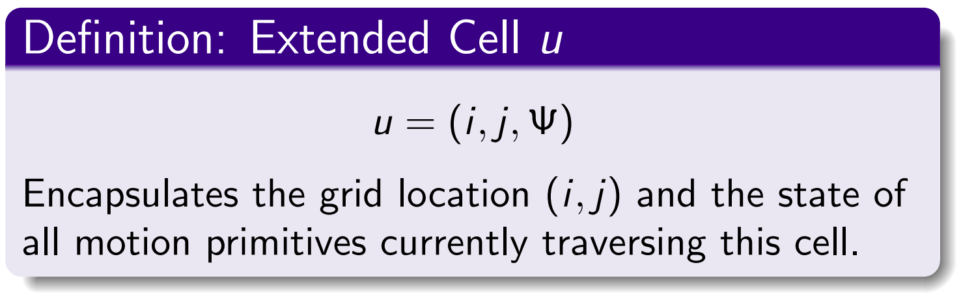
The Search Space: Mesh Graph
We define our search space as the Mesh Graph, its nodes are Extended Cells.
Example of Extended Cell u = (i, j, Ψ):
The magenta grid cell corresponds to the location (i, j).
The green lines represent the Configuration Ψ: the set of primitives passing through this cell (i, j) at a specific step k.

Slide 7
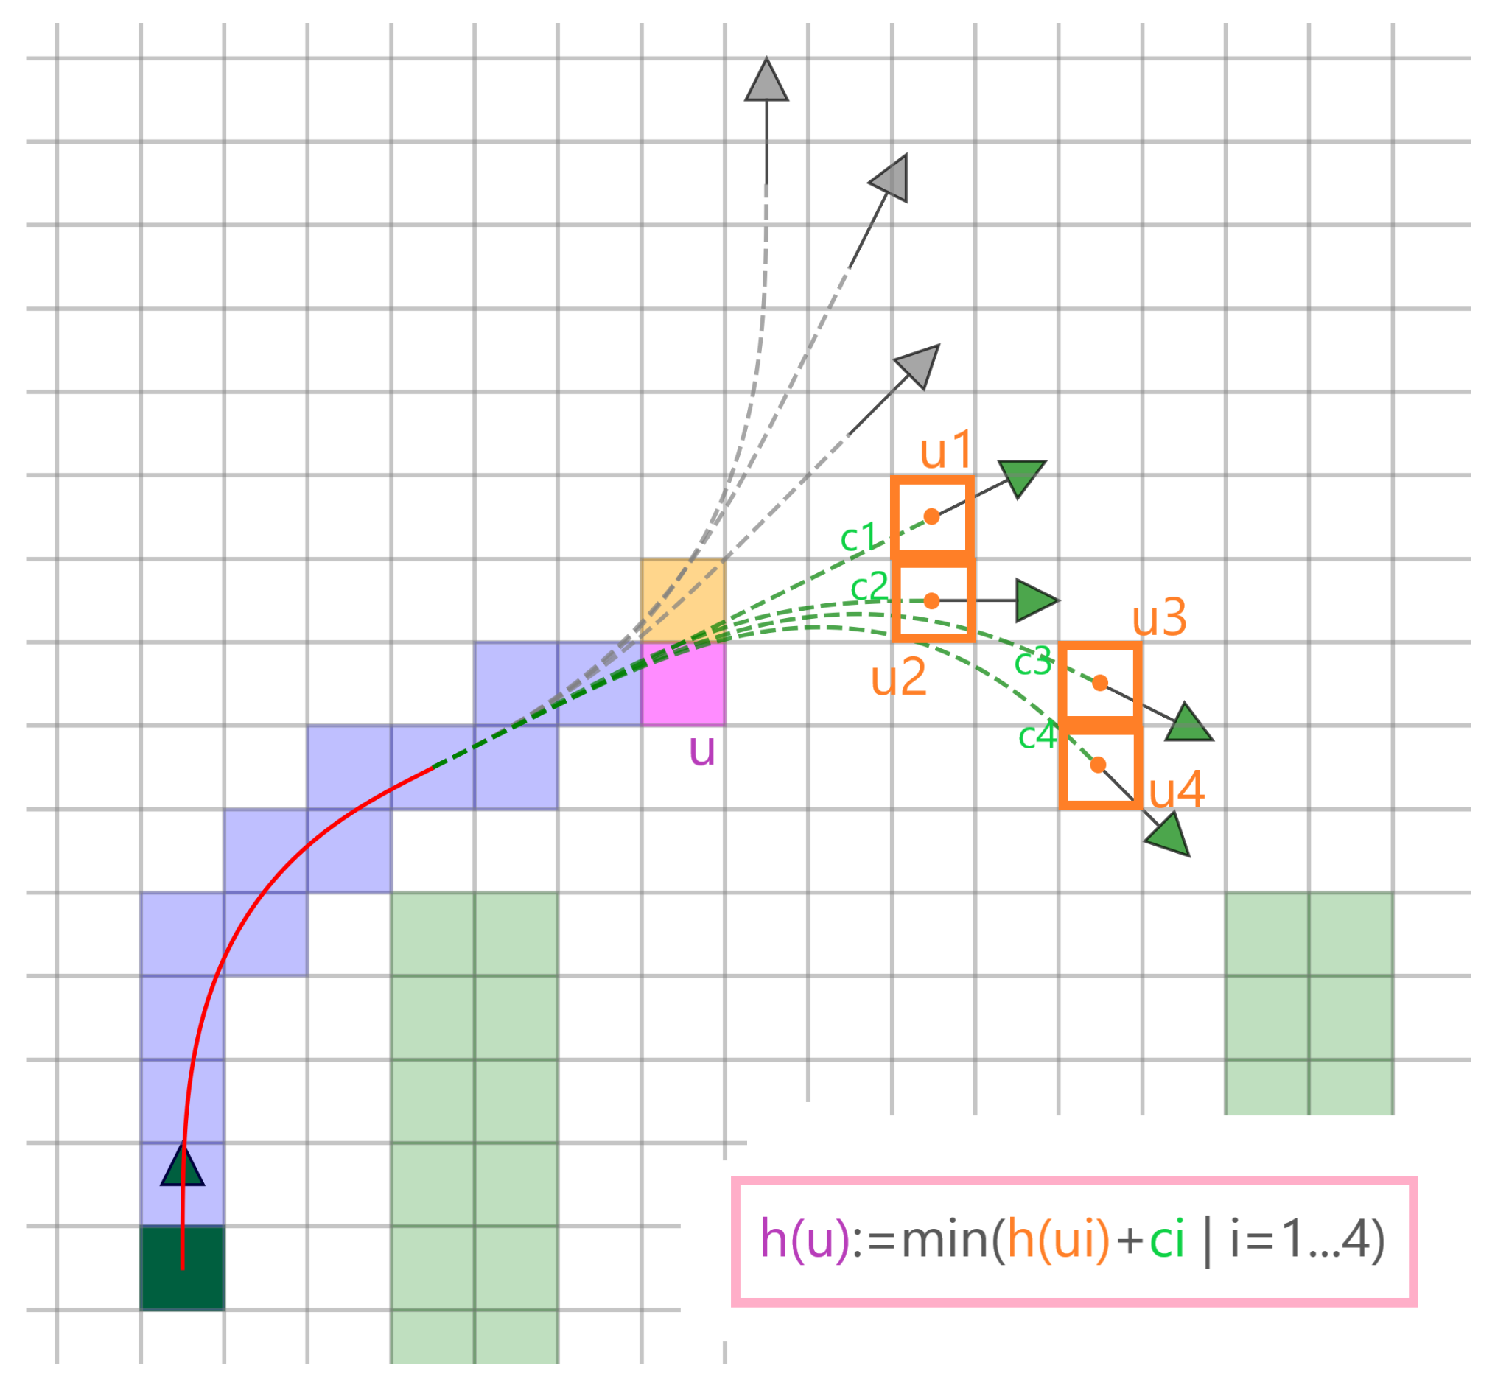
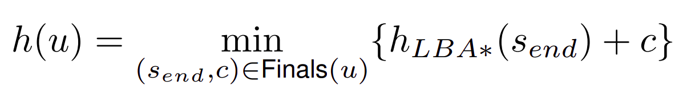
MeshA* Efficiency: Heuristics & Pruning
Primitive Endpoints: For extended cell u=(i, j, Ψ), Finals(u) is the set of all possible states where primitives from Ψ terminate.
Cell-Level Heuristic:
MeshA* re-evaluates heuristic at every grid cell:
h(u) = min { h_LBA*(v) + cost_to_finish }, wher
This allows to detect unpromising directions early and prune branches without traversing the full primitive.
Terminal Pruning: If all states in Finals(u) have already been expanded (closed), we stop expanding u immediately.
Visualization of Finals(u): orange cells.

Slide 8
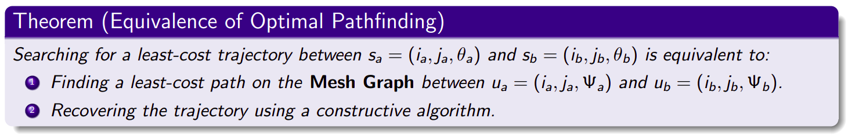
Theoretical Properties: Equivalence to State Lattice
Key Implications:
• Optimality: MeshA* guarantees finding the path with minimal cost (identical to LBA*).
• Completeness: If a solution exists in the State Lattice, MeshA* will find it.

Slide 9
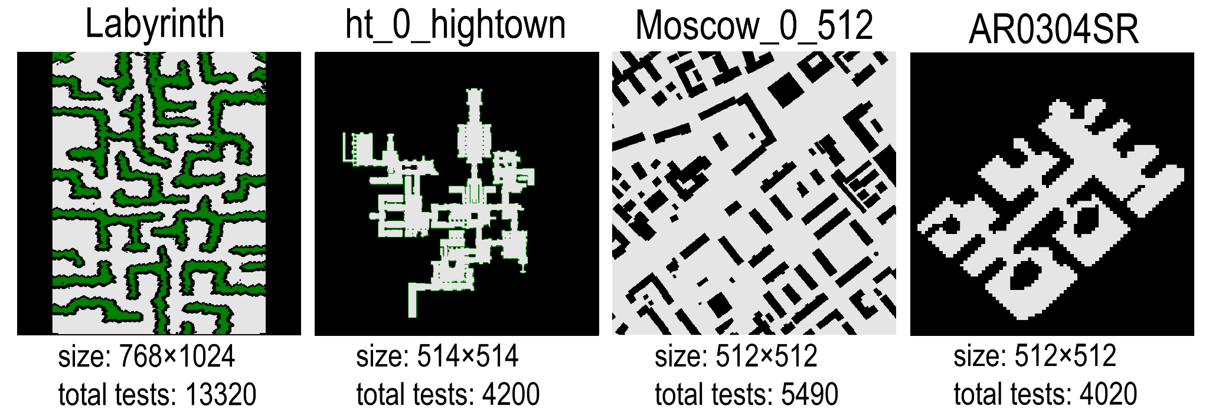
Experimental Setup
Setup & Benchmark:
Maps: 4 maps from MovingAI benchmark (varying topology).
Instances: >25,000 start-goal pairs (from MovingAI scenarios) with random headings.
Control set: 16 discrete headings, 24 primitives per heading.
Primitive cost: length
Baselines:
LBA* (Standard Lattice-based A*)
LazyLBA* (lazy collision checking)
Heuristics:
LBA*: Euclidean distance
MeshA*: a derivative of Euclidean one
Weights: w ∈ {1, 1.1, 2, 5, 10}
(factors for heuristics of both MeshA* and LBA*)
Maps from https://movingai.com/benchmarks/grids.html

Slide 10
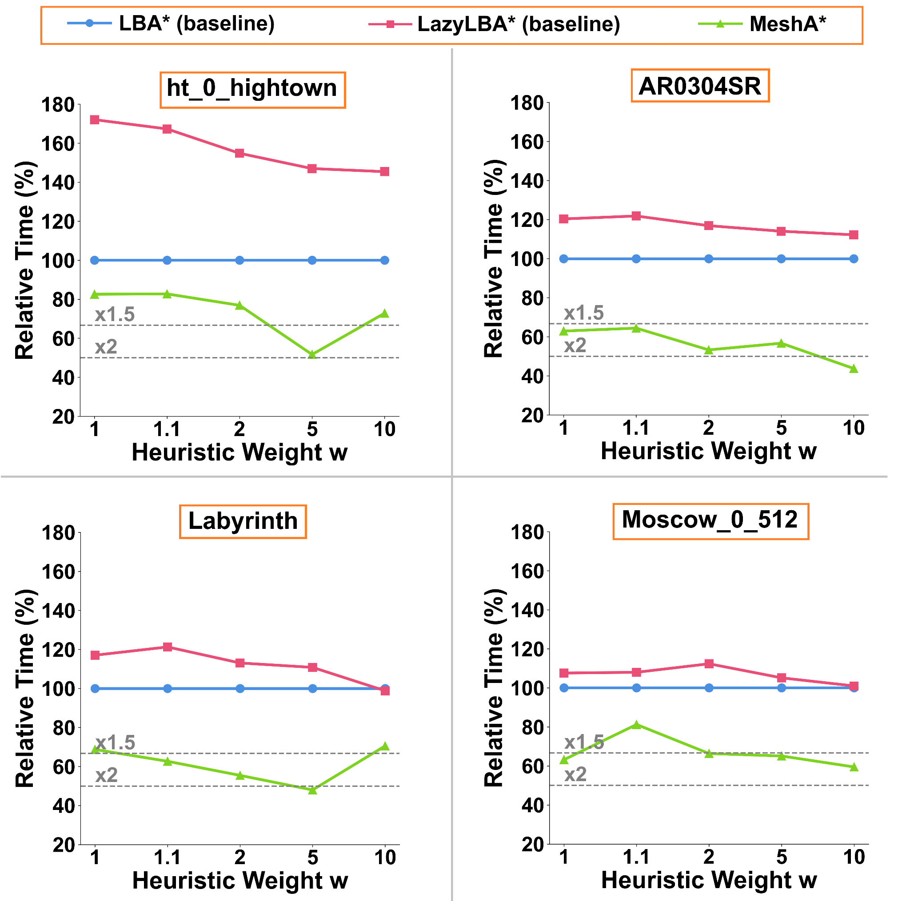
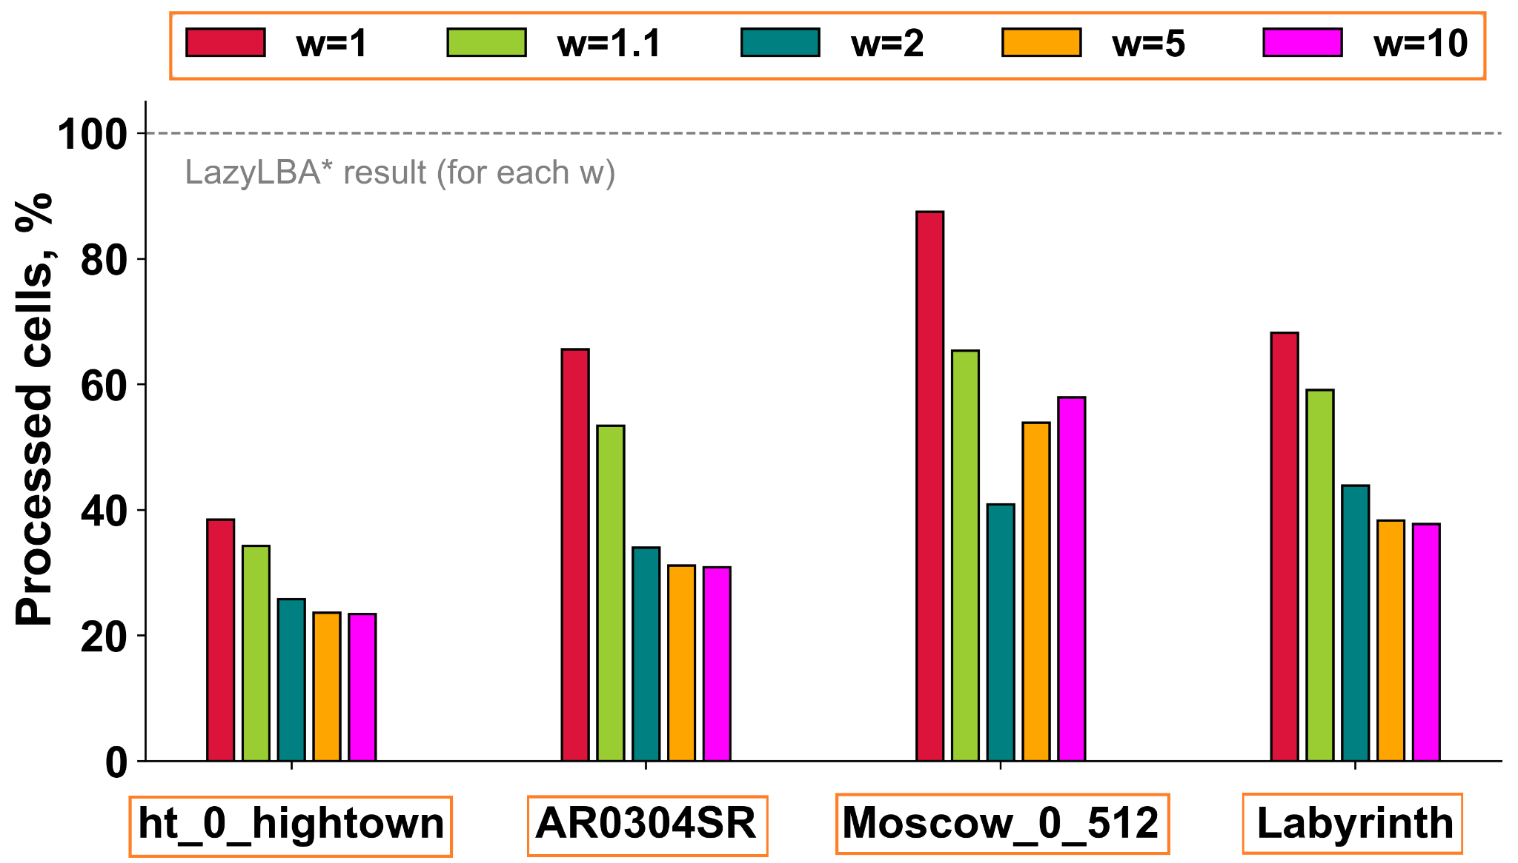
Empirical Results: Runtime & Efficiency
Key Results for MeshA*:
1.5x - 2x faster than LBA* and LazyLBA*.
Processes ≈ 50% fewer grid cells than LazyLBA*.

Slide 11
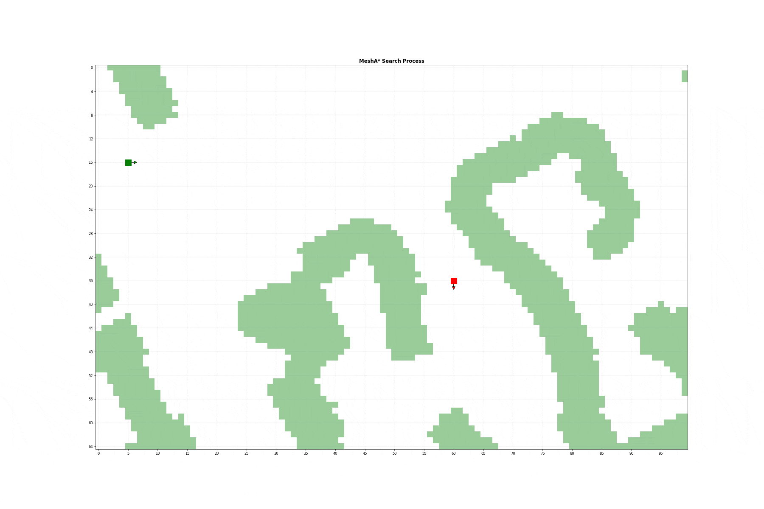
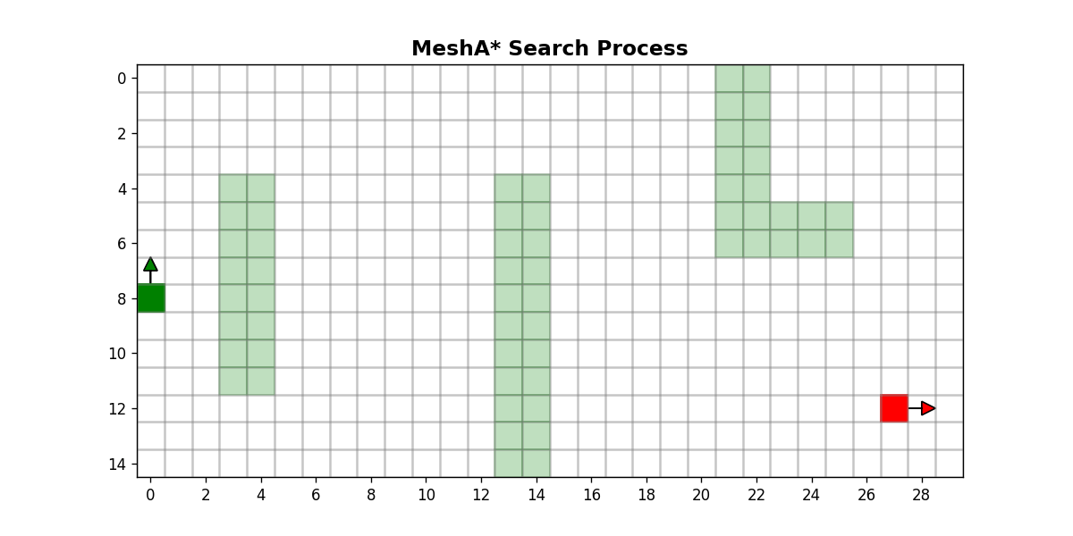
MeshA* in Action
Cell-by-Cell Propagation The search expands grid cells incrementally, strictly guided by the geometry of primitive bundles.
Effective Branching Factor. In the end the visualization retains only one representative primitive per indistinguishable bundle to illustrate the actual search complexity.

Slide 12
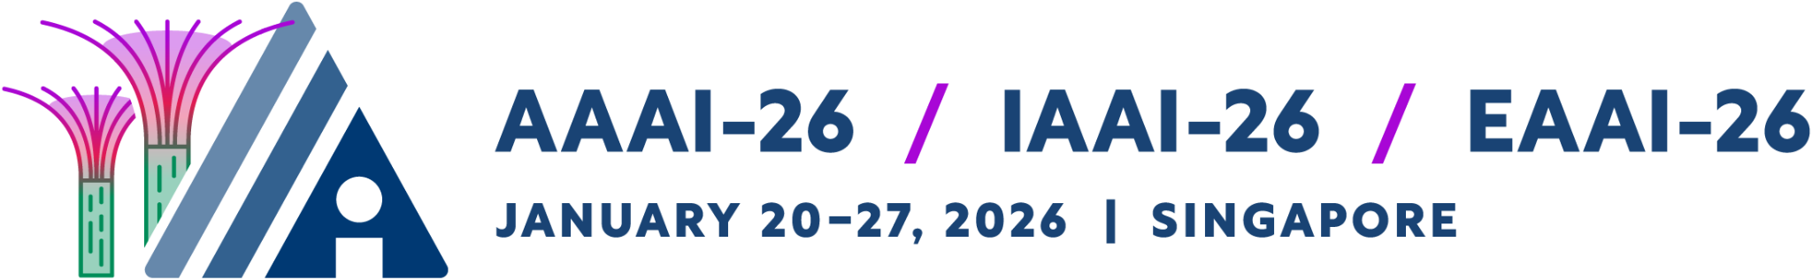
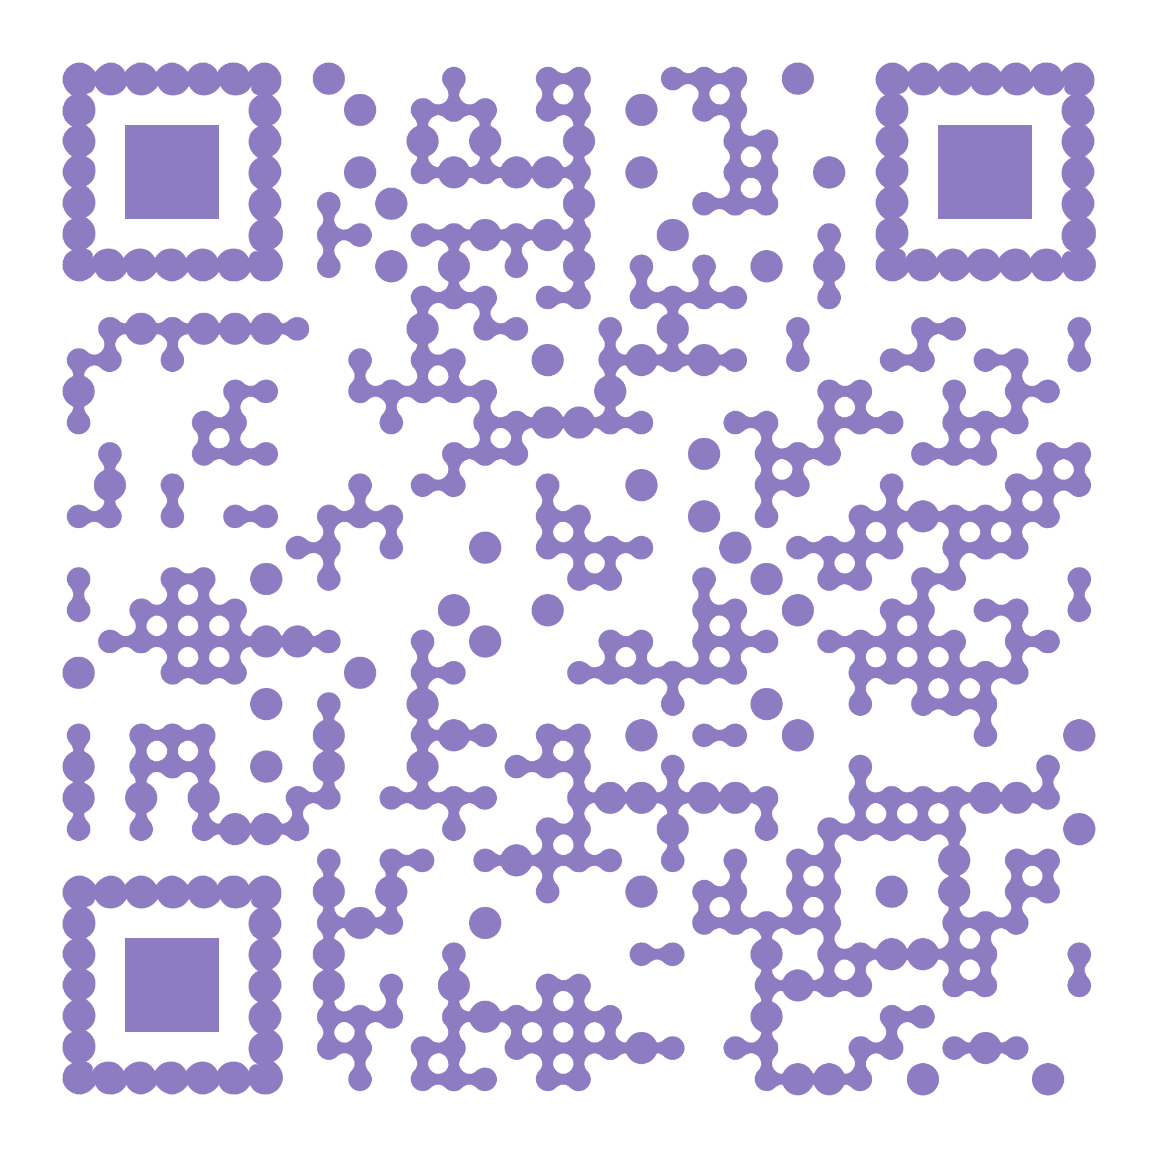
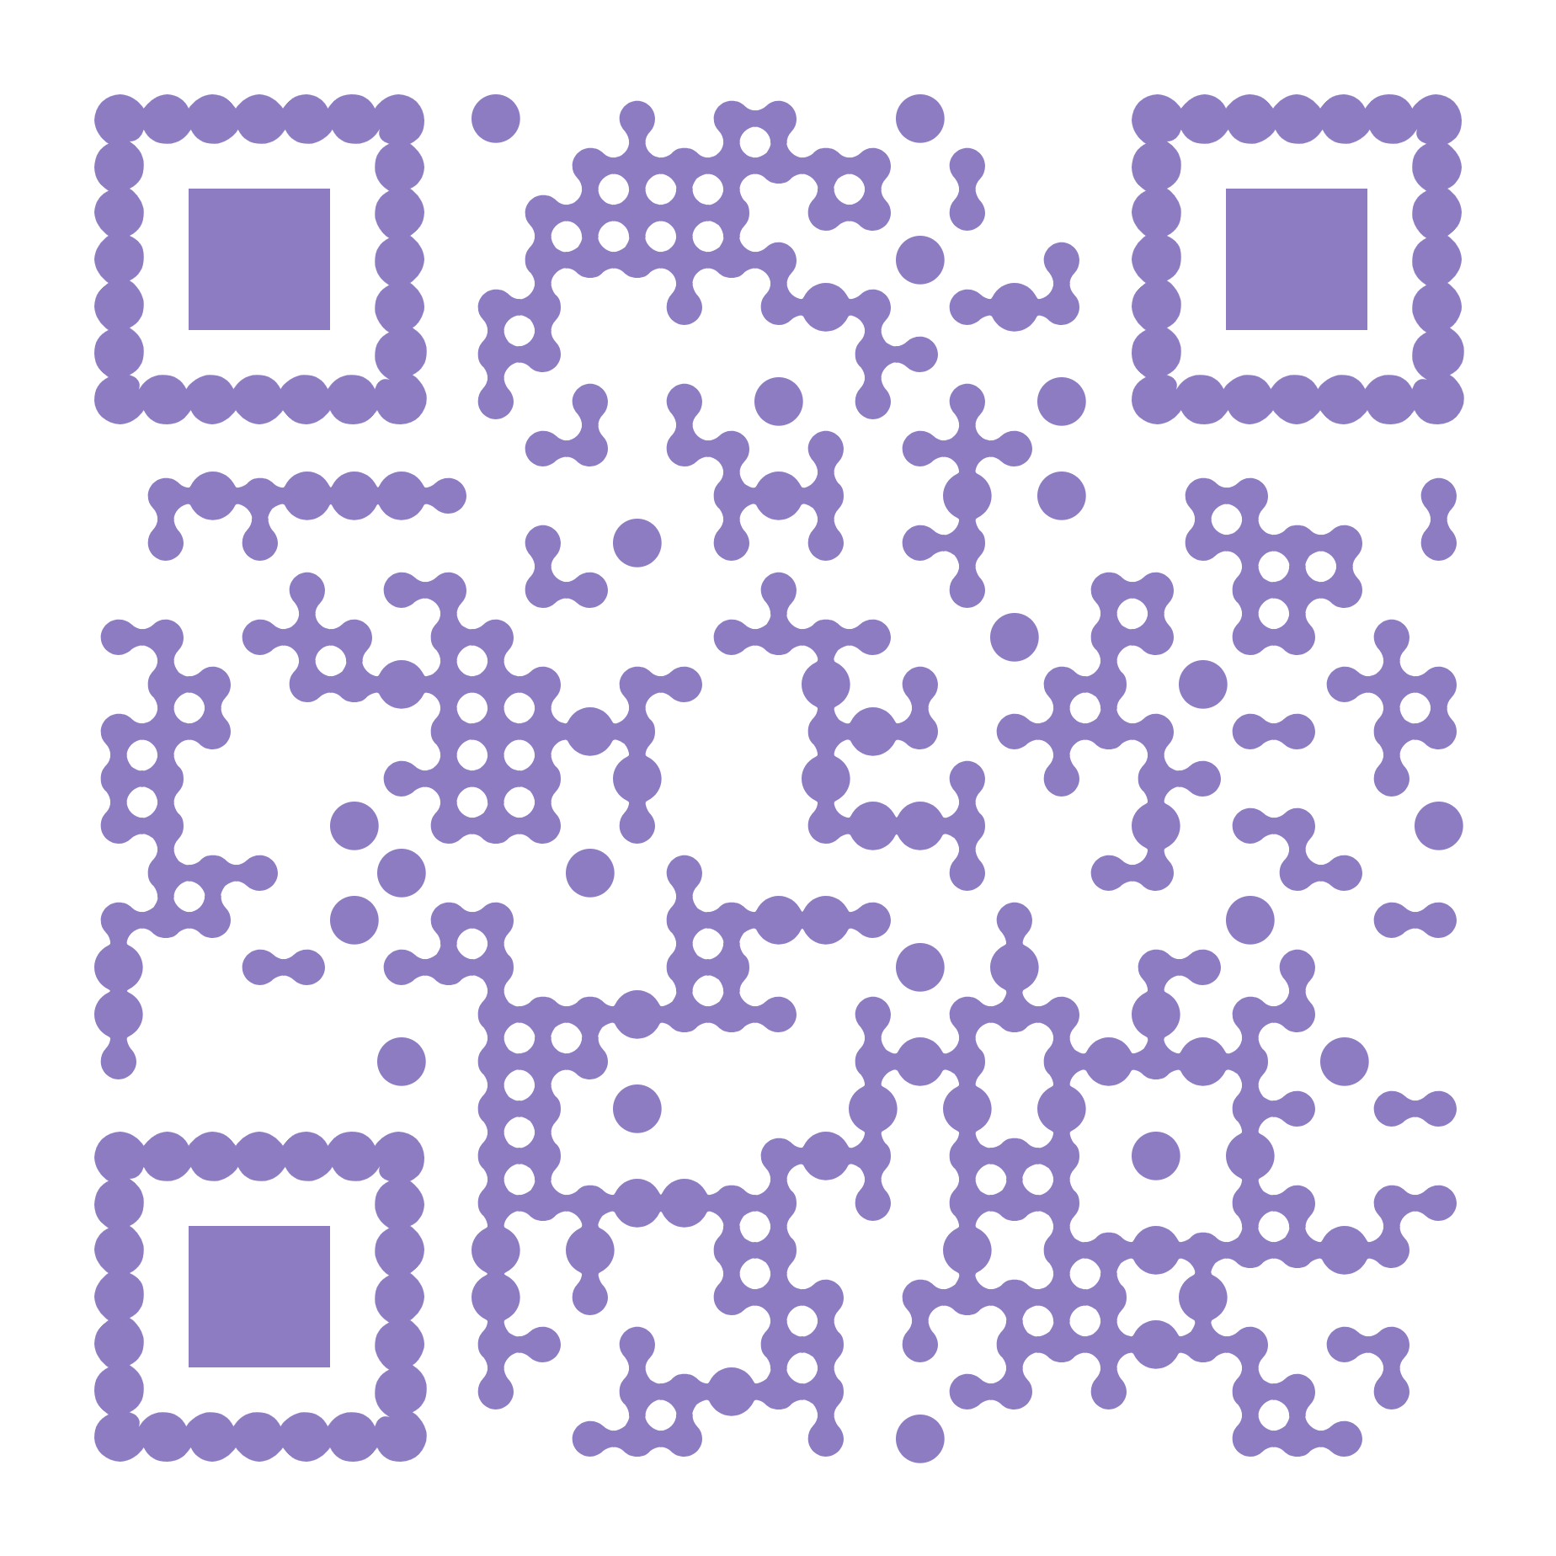
Thank you for your attention!
For further questions about MeshA*:
agrinscience@gmail.com
Code
ArXiv

